Slide 2
Unit Objectives
Insert an image
Align an image
Enhance an image
Use alternate text and set Accessibility preferences
View the Assets panel
Insert a background image
Delete image files from a website
Create and find images for a website
Examine copyright rules

Slide 3
Inserting an Image
Start Dreamweaver
Open The Striped Umbrella Website
Open dwe_1.html
Save it as about_us.html in the striped_umbrella root folder, overwriting the existing file and not updating the links
Then close dwe_1.html
Click the Attach Style Sheet button in the CSS Styles panel
Attach the su_styles.css style sheet
Then apply the nav_bar rule to the menu bar, the Heading 1 paragraph format to “Welcome guests!”, and the body_text rule to all of the paragraph text on the page

Slide 4
Inserting an Image
Click to the left of the word “When” in the first paragraph
Select the Common category on the Insert panel if necessary
Click the Images list arrow on the Insert panel, then click Image
Navigate to drive and folder where you store your files
Double click club_house.jpg from the assets folder
Type Club House in the Image Tag Accessibility Attributes dialog box, click OK
Click the Refresh button on the Files panel toolbar if necessary

Slide 5
Inserting an Image
Save the file, click the Assets panel tab, click the Images button on the Assets panel if necessary
Click the Refresh button at the bottom of the Assets panel, if necessary
Repeat steps 3 and 4 to insert the boardwalk.png image at the beginning of the second paragraph
If prompted, enter alternate text

Slide 6
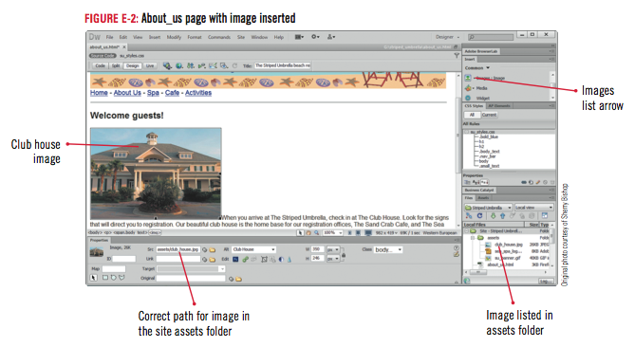
Inserting an Image

Slide 7
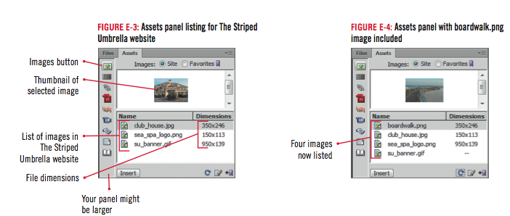
Inserting an Image

Slide 8
Aligning an Image
Click the New css Rule button in the CSS Styles panel
Click Class in the selector type list box, type img_left_float for the selector name, verify that it will be saved in the su_styles.css file, then click OK
Click the Box category, click the Float list arrow, click left, then click OK
Click the club house image if necessary, click the Class list arrow on the right side of the Property inspector, then click img_left_float

Slide 9
Aligning an Image
Close the browser window
Repeat steps 1 through 3 to create another rule named img_right_float with a Float value of right
Apply the img_right_float rule to the boardwalk image
Click File, Save All to save your work

Slide 10
Design Matters
Using dynamic images
To make a page even more interesting, you can place images on the page that change frequently, such as a group of several images that are set to automatically cycle on and off the page, called dynamic images

Slide 11
Aligning an Image

Slide 12
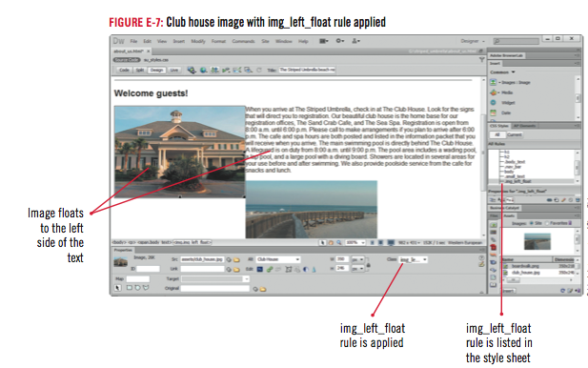
Aligning an Image

Slide 13
Enhancing an Image
Click the img_left_float rule in the CSS Styles panel, click the Edit Rule button, click the Border Category, enter the rule properties, then click OK
Repeat step 1 to add a border to the img_right_float rule
Edit the img_left_float rule again to add vertical and horizontal space by unchecking the “same for all” check box under Margin in the box category, then setting the box Right Margin to 10 px, then click OK

Slide 14
Enhancing an Image
Using step 3 as a guide, add a border and a 10 px left margin to the img_right_float rule
Save your work, open the spa page, then apply the img_left_float rule to the spa logo
Click File, Save All, to save all files, then close the spa page

Slide 15
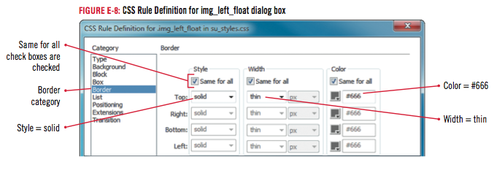
Enhancing an Image

Slide 16
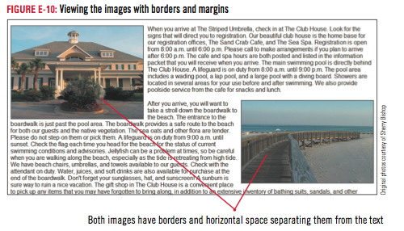
Enhancing an Image

Slide 17
Clues to Use
Simply select the image, then drag a selection handle toward the center of the image
Hold [Shift] to retain original proportions
The new dimensions appear in the Property inspector in bold
Do not use this method to significantly resize an image

Slide 18
Using Alternate Text and Setting Accessibility Preferences
Click the club house image to select it
Select the text in the Alt text box in the Property inspector
Type The Striped Umbrella Club House, press [Tab], then save the file
Repeat step 1 to edit alternate text for boardwalk image

Slide 19
Using Alternate Text and Setting Accessibility Preferences
Click Edit on the Menu bar (Win) or Dreamweaver on the Menu bar (Mac)
Click Preferences
Click Accessibility in the Category list
Click the Show attributes when inserting check boxes to select them
Then click OK
Save your work

Slide 20
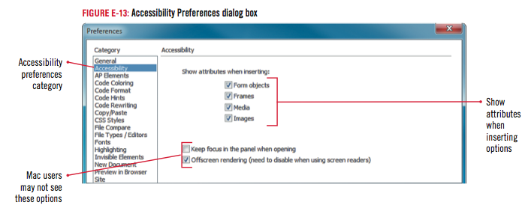
Using Alternate Text and Setting Accessibility Preferences

Slide 21
Design Matters
Providing for accessibility with alternate text
Avoid using more than 50 characters
Create a separate file for alternate text over 50 characters
Enter the location of the file in the Long Description text box

Slide 22
Viewing the Assets Panel
Click the Assets tab in the Files Tab group, if necessary
Click the Images button on the Assets panel, if necessary
Click the Colors button to display the Colors category

Slide 23
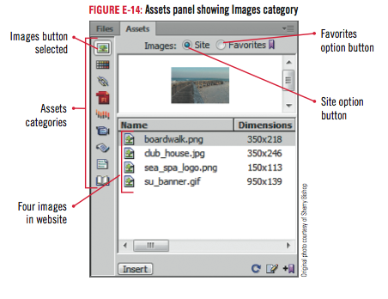
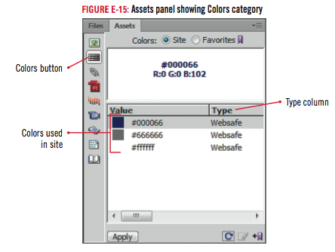
Viewing the Assets Panel

Slide 24
Clues to Use
“Graphics” versus “Images”
Graphics refer to most non-text items on the Web page
Examples: photographs, logos, navigation bars, Flash animations, graphs, background images, and illustrations
Images refer to pictures or photographs
Narrower term
Referred to by file type: JPEG, GIF, PNG

Slide 25
Clues to Use
Using Favorites in the Assets panel
Place frequently-used assets in the Favorites list in the Assets panel
Right-click (Win) or [ctrl]-click (Mac) an image in Design view, then click Add to Image Favorites
Clicking the Favorites option in the Assets panel will display the image in the list

Slide 26
Inserting a Background Image
Click Modify on the Menu bar, then click Page Properties
Click the Appearance (CSS) category, if necessary
Click Browse next to the Background image text box, navigate to the drive and folder where your files are stored, double-click the assets folder, double-click water.jpg, then click OK
Expand the CSS Styles panel if necessary
Click the <style> tag in the CSS Styles panel, then press the Delete button on the CSS Styles panel

Slide 27
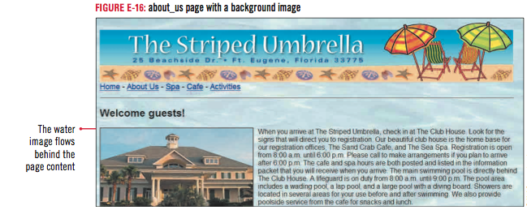
Inserting a Background Image

Slide 28
Clues to Use
Integrating Photoshop and Fireworks with Dreamweaver CS6
Smart Objects are layers with image source info that allow an image to be modified nondestructively without losing the original data
Users can set Photoshop as the default image editor

Slide 29
Deleting Image Files from a Website
Display the Assets panel, if necessary, click the Images button on the Assets panel, verify that the Site option is selected, then click the Refresh button on the Assets panel
Right-click water.jpg in the Assets panel, then click Locate in Site
Press [Delete] to delete the file, click Yes in the confirmation dialog box
Save your work, then preview your file in your browser
Close the page, then Exit (Win) or Quit (Mac) Dreamweaver

Slide 30
Clues to Use
Inserting files with Adobe Bridge
View files outside the Website before bringing them into the site
Integrated with Photoshop and Illustrator
Add meta tags and search text
To open Bridge, click Browse in Bridge on the File menu, or click the Browse in Bridge button on the Standard toolbar

Slide 31
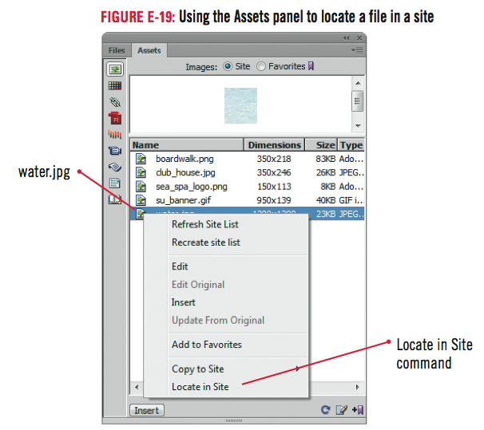
Deleting Image Files from a Website

Slide 32
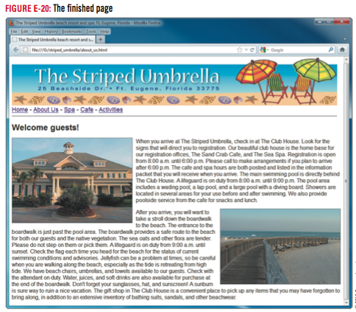
Deleting Image Files from a Website

Slide 33
Design Matters
Image file management
Store original, unedited copies of images in a separate folder
Save edited files under a different name
Keep assets folder free of clutter

Slide 34
Creating and Finding Images for a Website
Original Images
Can set transparent background
Original Photography
The Internet
Be conscious of copyright laws

Slide 35
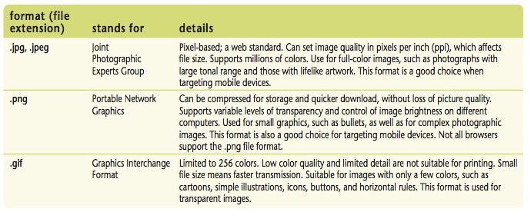
Creating and Finding Images for a Website

Slide 36
Examine Copyright Rules
Intellectual property
Product resulting from human creativity
Examples: inventions, movies, songs
Copyright
Protects the tangible expression of an idea
Trademark
Protects image, slogan, or design
Fair Use
Allows limited use under certain circumstances
Derivative Work
Based on another pre-existing work
Public Domain
Use free of charge

Slide 37
Unit Summary
Insert an image
Align an image
Enhance an image
Use alternate text and set Accessibility preferences
View the Assets panel
Insert a background image
Delete image files from a website
Create and find images for a website
Examine copyright rules

